Slide 1
FINAL Project
DMIT 2504 OA03
By R Charitra

Slide 2
GK Quiz
This application is a simple GK questionnaire implementation.
The API I used for this application is https://opentdb.com/api_config.php
I used Volley for transporting the data from the API

Slide 3
Model
Question Class
Three Properties
Question
Answer
Incorrect answer

Slide 4
Data
Questions
Method for getting data
Remove unwanted strings
An Interface to allow Async Task

Slide 5
Controller
Volley App Controller Class
Get Instance
Get Request Queue

Slide 6
Volley
A library for transporting data from an API
Like fetch API in JavaScript
Returns either a JSON Array or JSON object

Slide 7
DRAWABLE Resources
Buttons
Input Field
Custom Row

Slide 8
Animation
XML Based
Animator Class

Slide 9
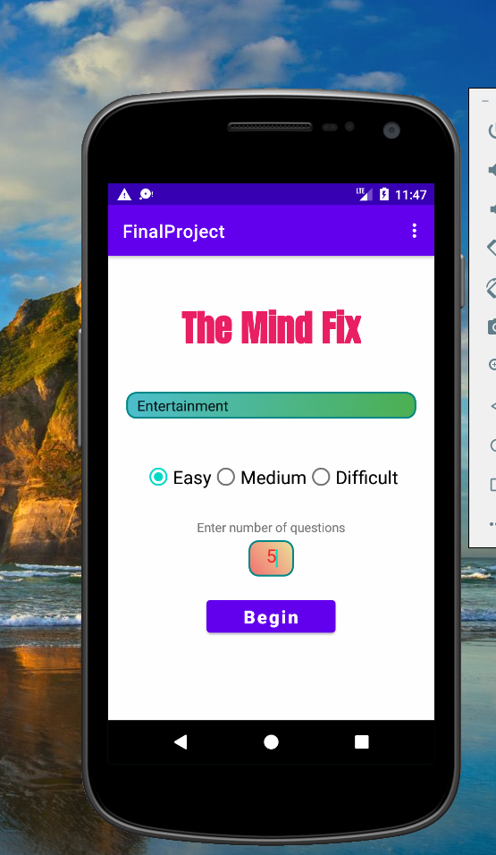
Main Screen

Slide 10
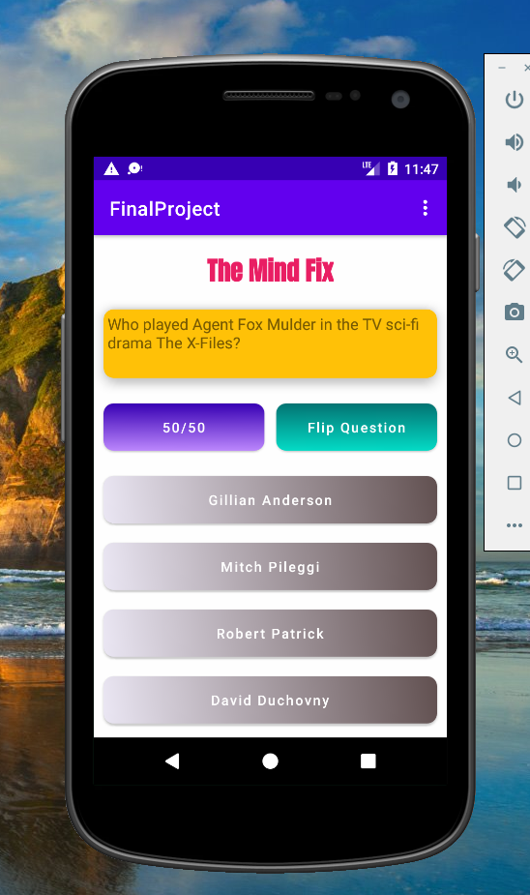
Game Screen

Slide 11
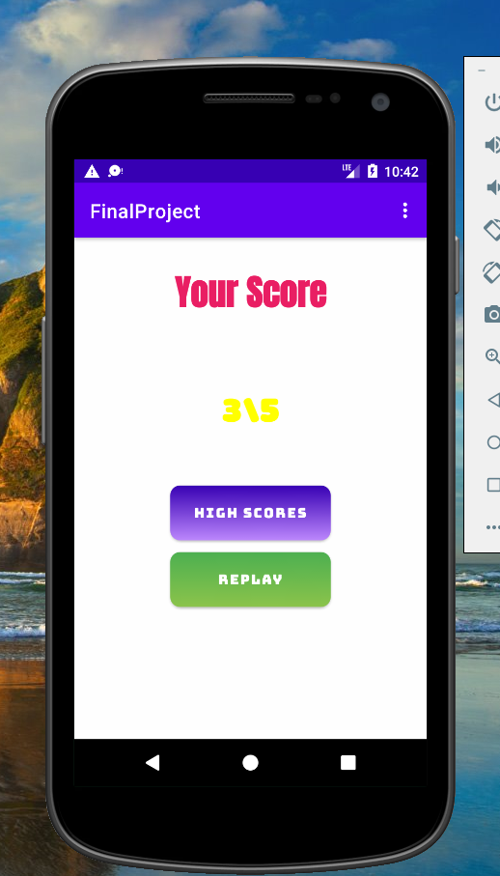
Result Screen

Slide 12
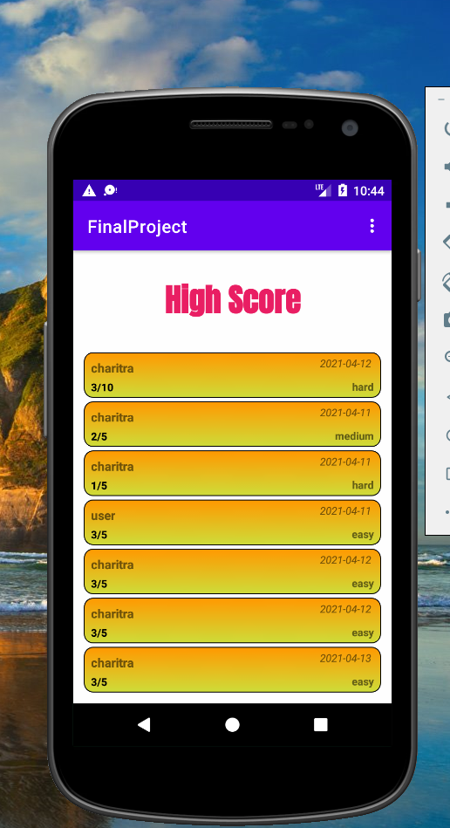
High SCORE Screen

Slide 13
DEMO TIME

Slide 14
Thanks
Questions?

